Slide 1

Attendance
Roster
Report
Click to Begin

Slide 2
Error!
Please follow the on-screen
instructions to continue.
Go Back

Slide 3
Complete
Please navigate to the next module
in the course to continue.
Restart Course

Slide 4
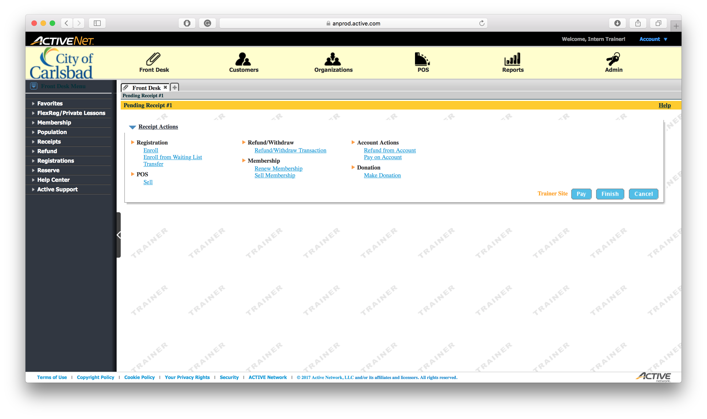
Tip:
Select the Reports module
This is where we print all reports

Slide 5
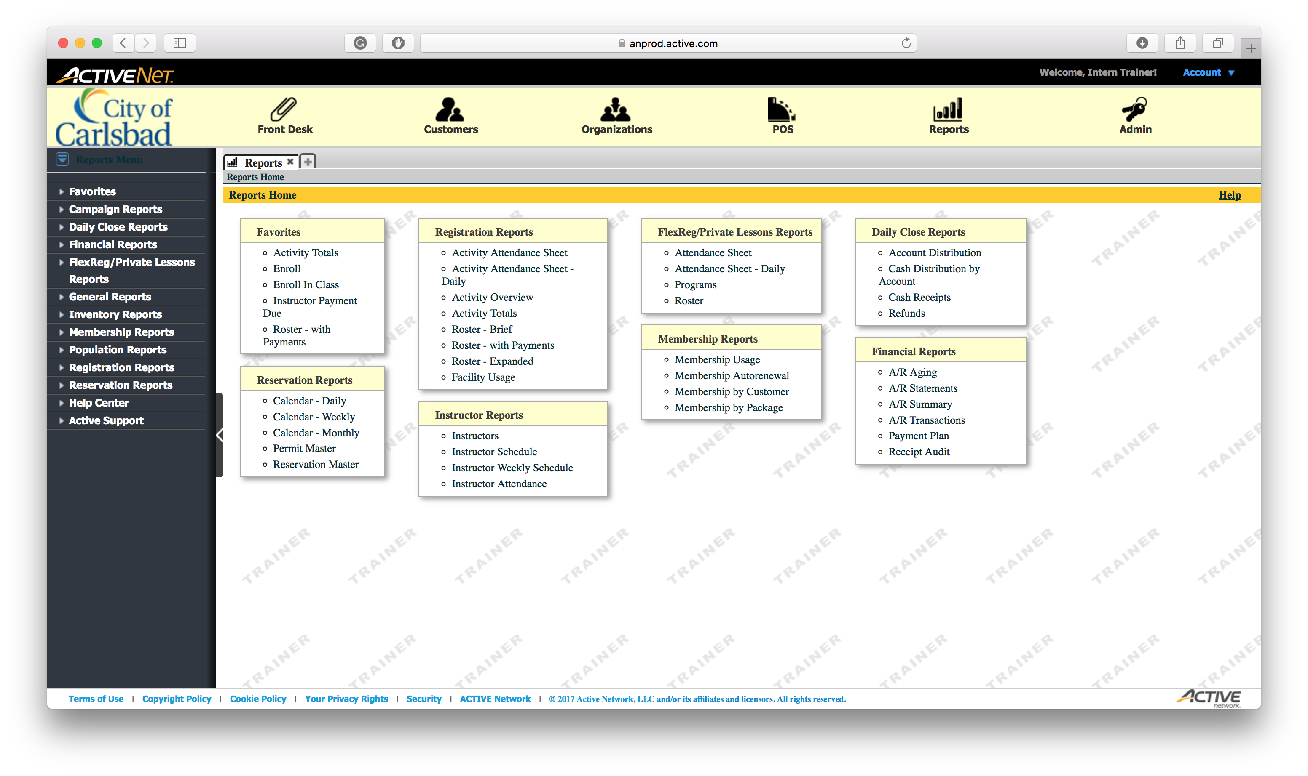
Tip:
Select the Activity Attendance option
This can be found in the left center of the main page.

Slide 6
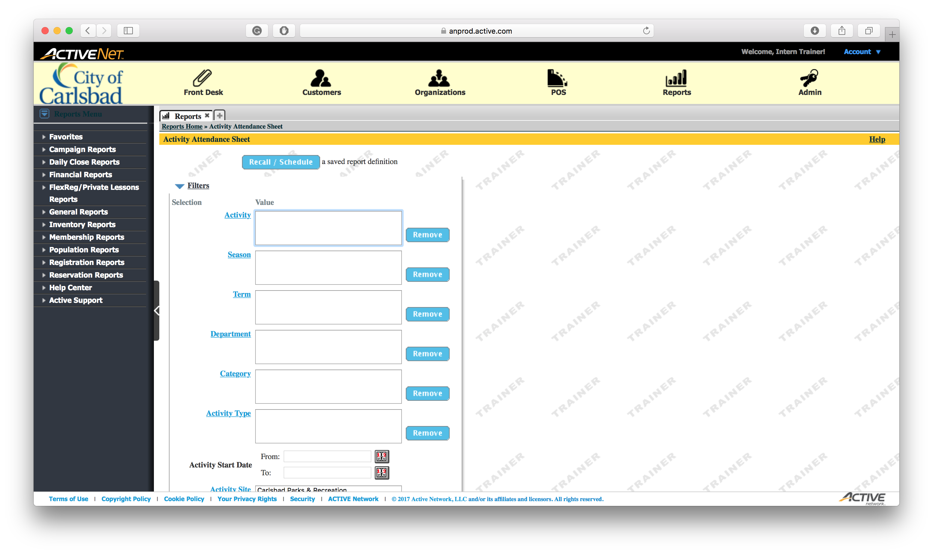
Tip:
Select the Activity
Not putting an activity returns all data in our system

Slide 7
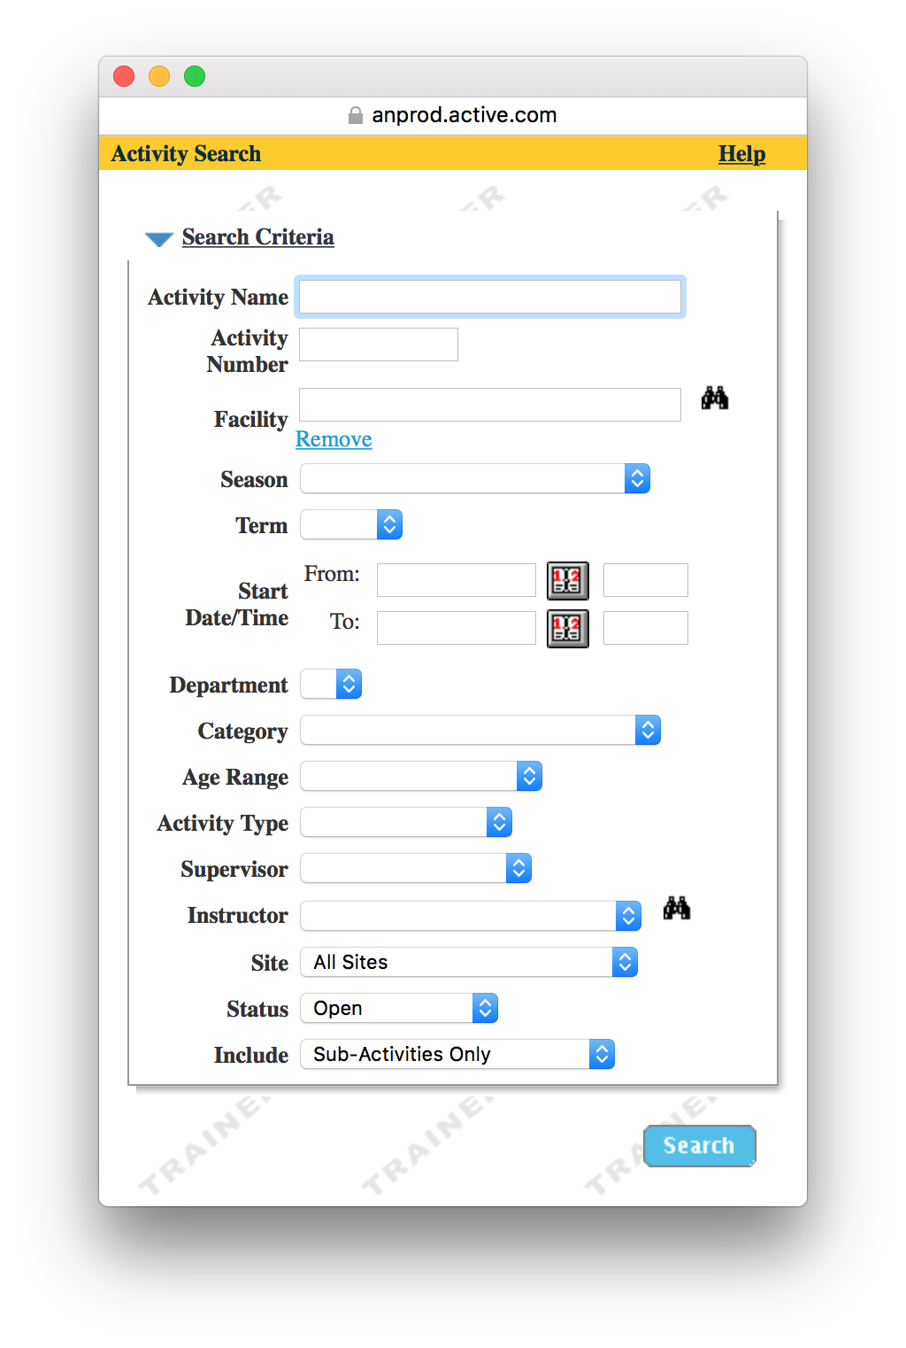
Tip:
Input the Activity Number

Slide 8
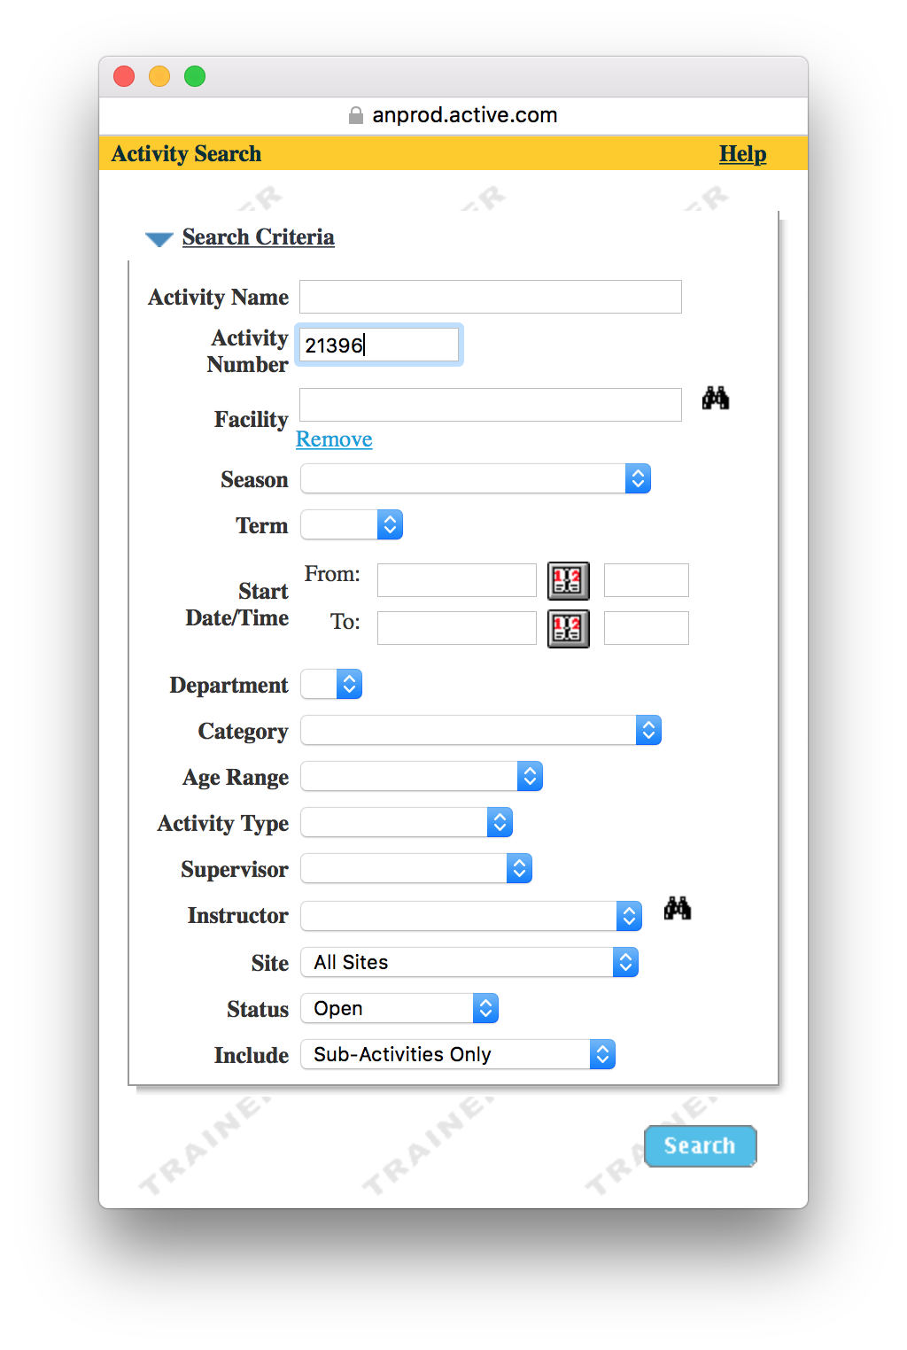
Tip:
Click Search

Slide 9
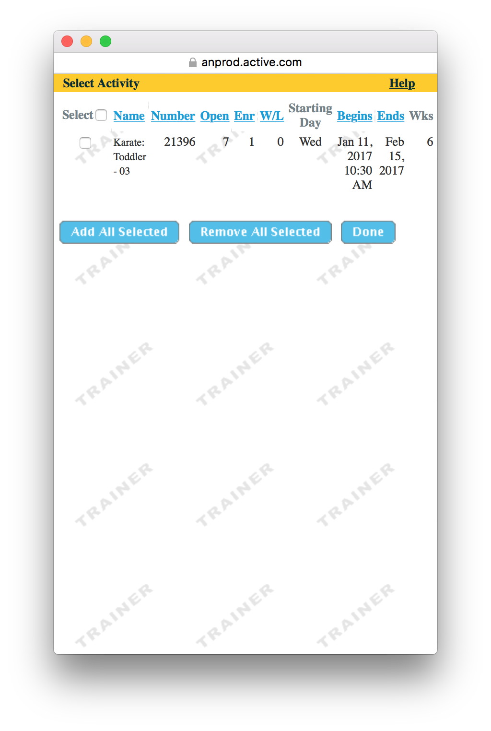
Tip:
Check the activity courses you need

Slide 10
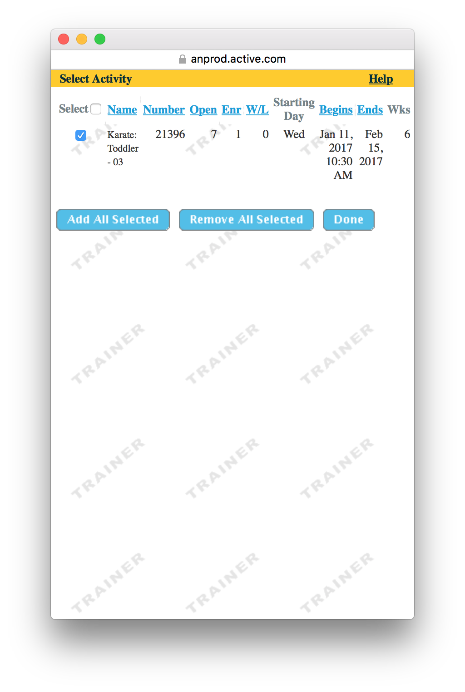
Tip:
Click Done

Slide 11
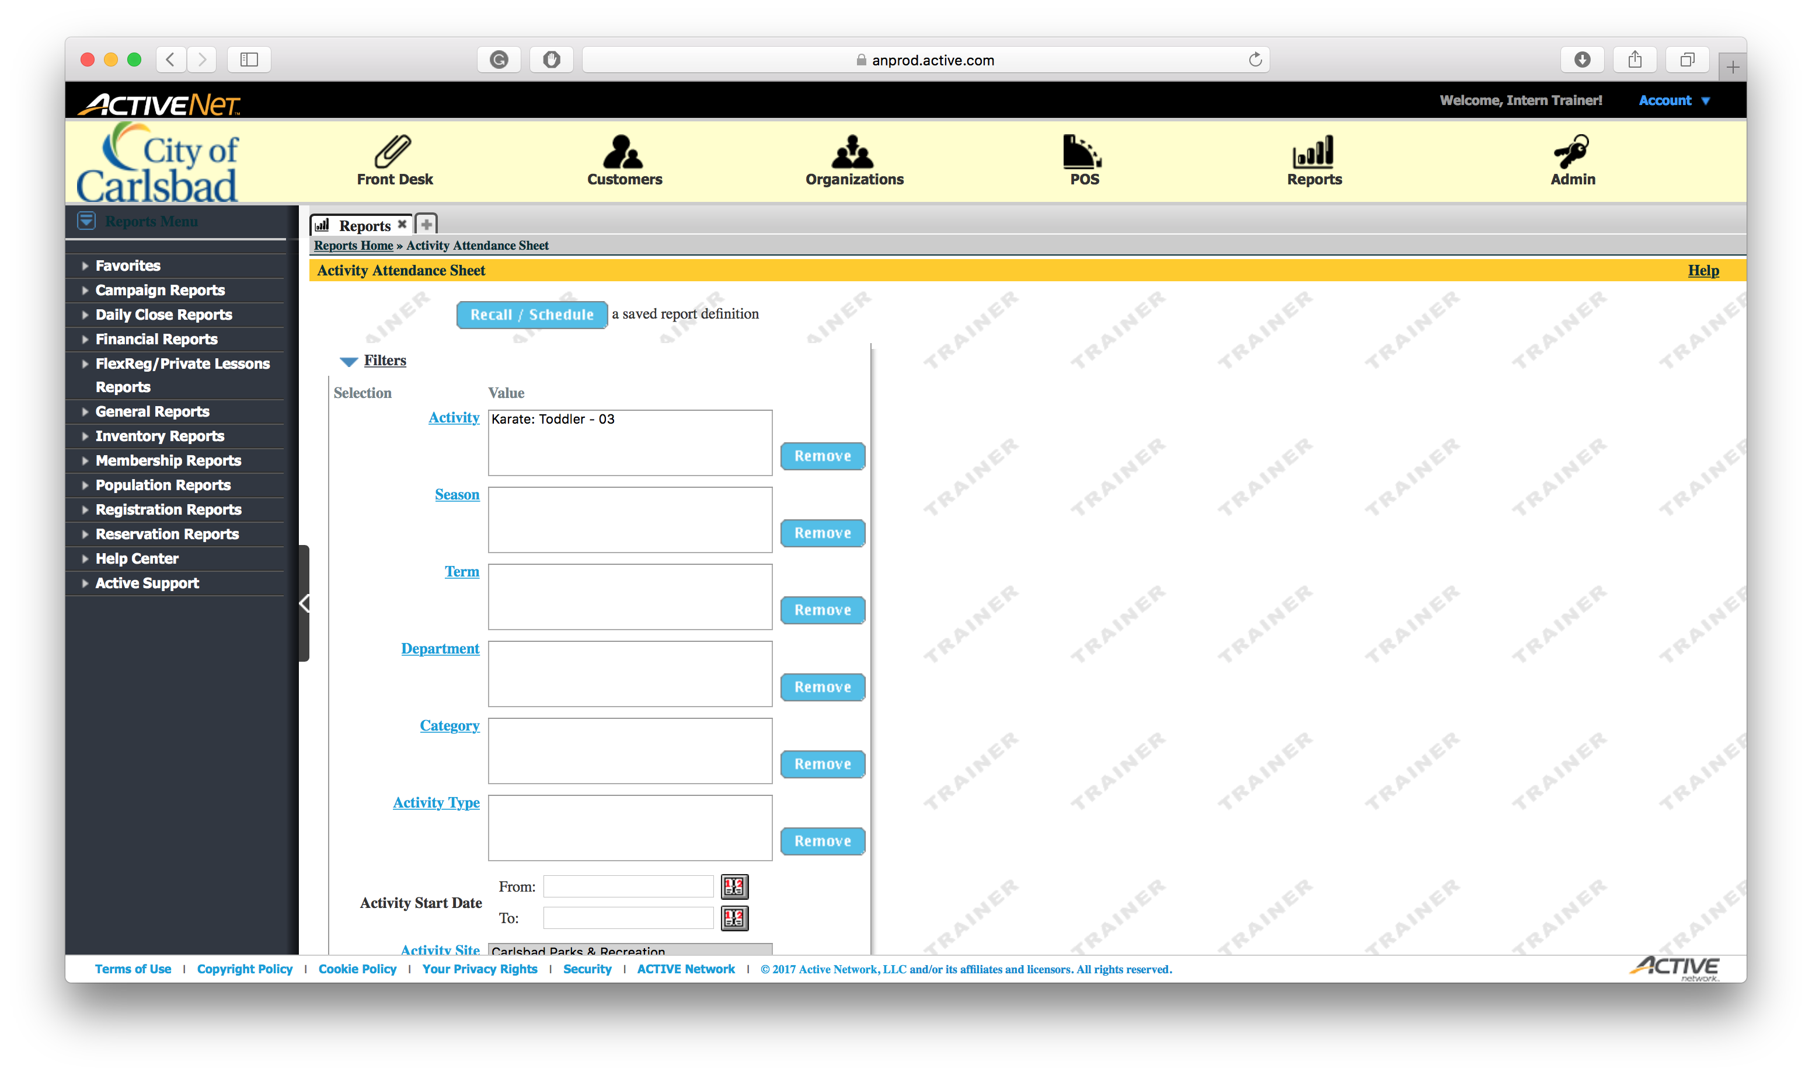
Tip:
Hide the filters section

Slide 12
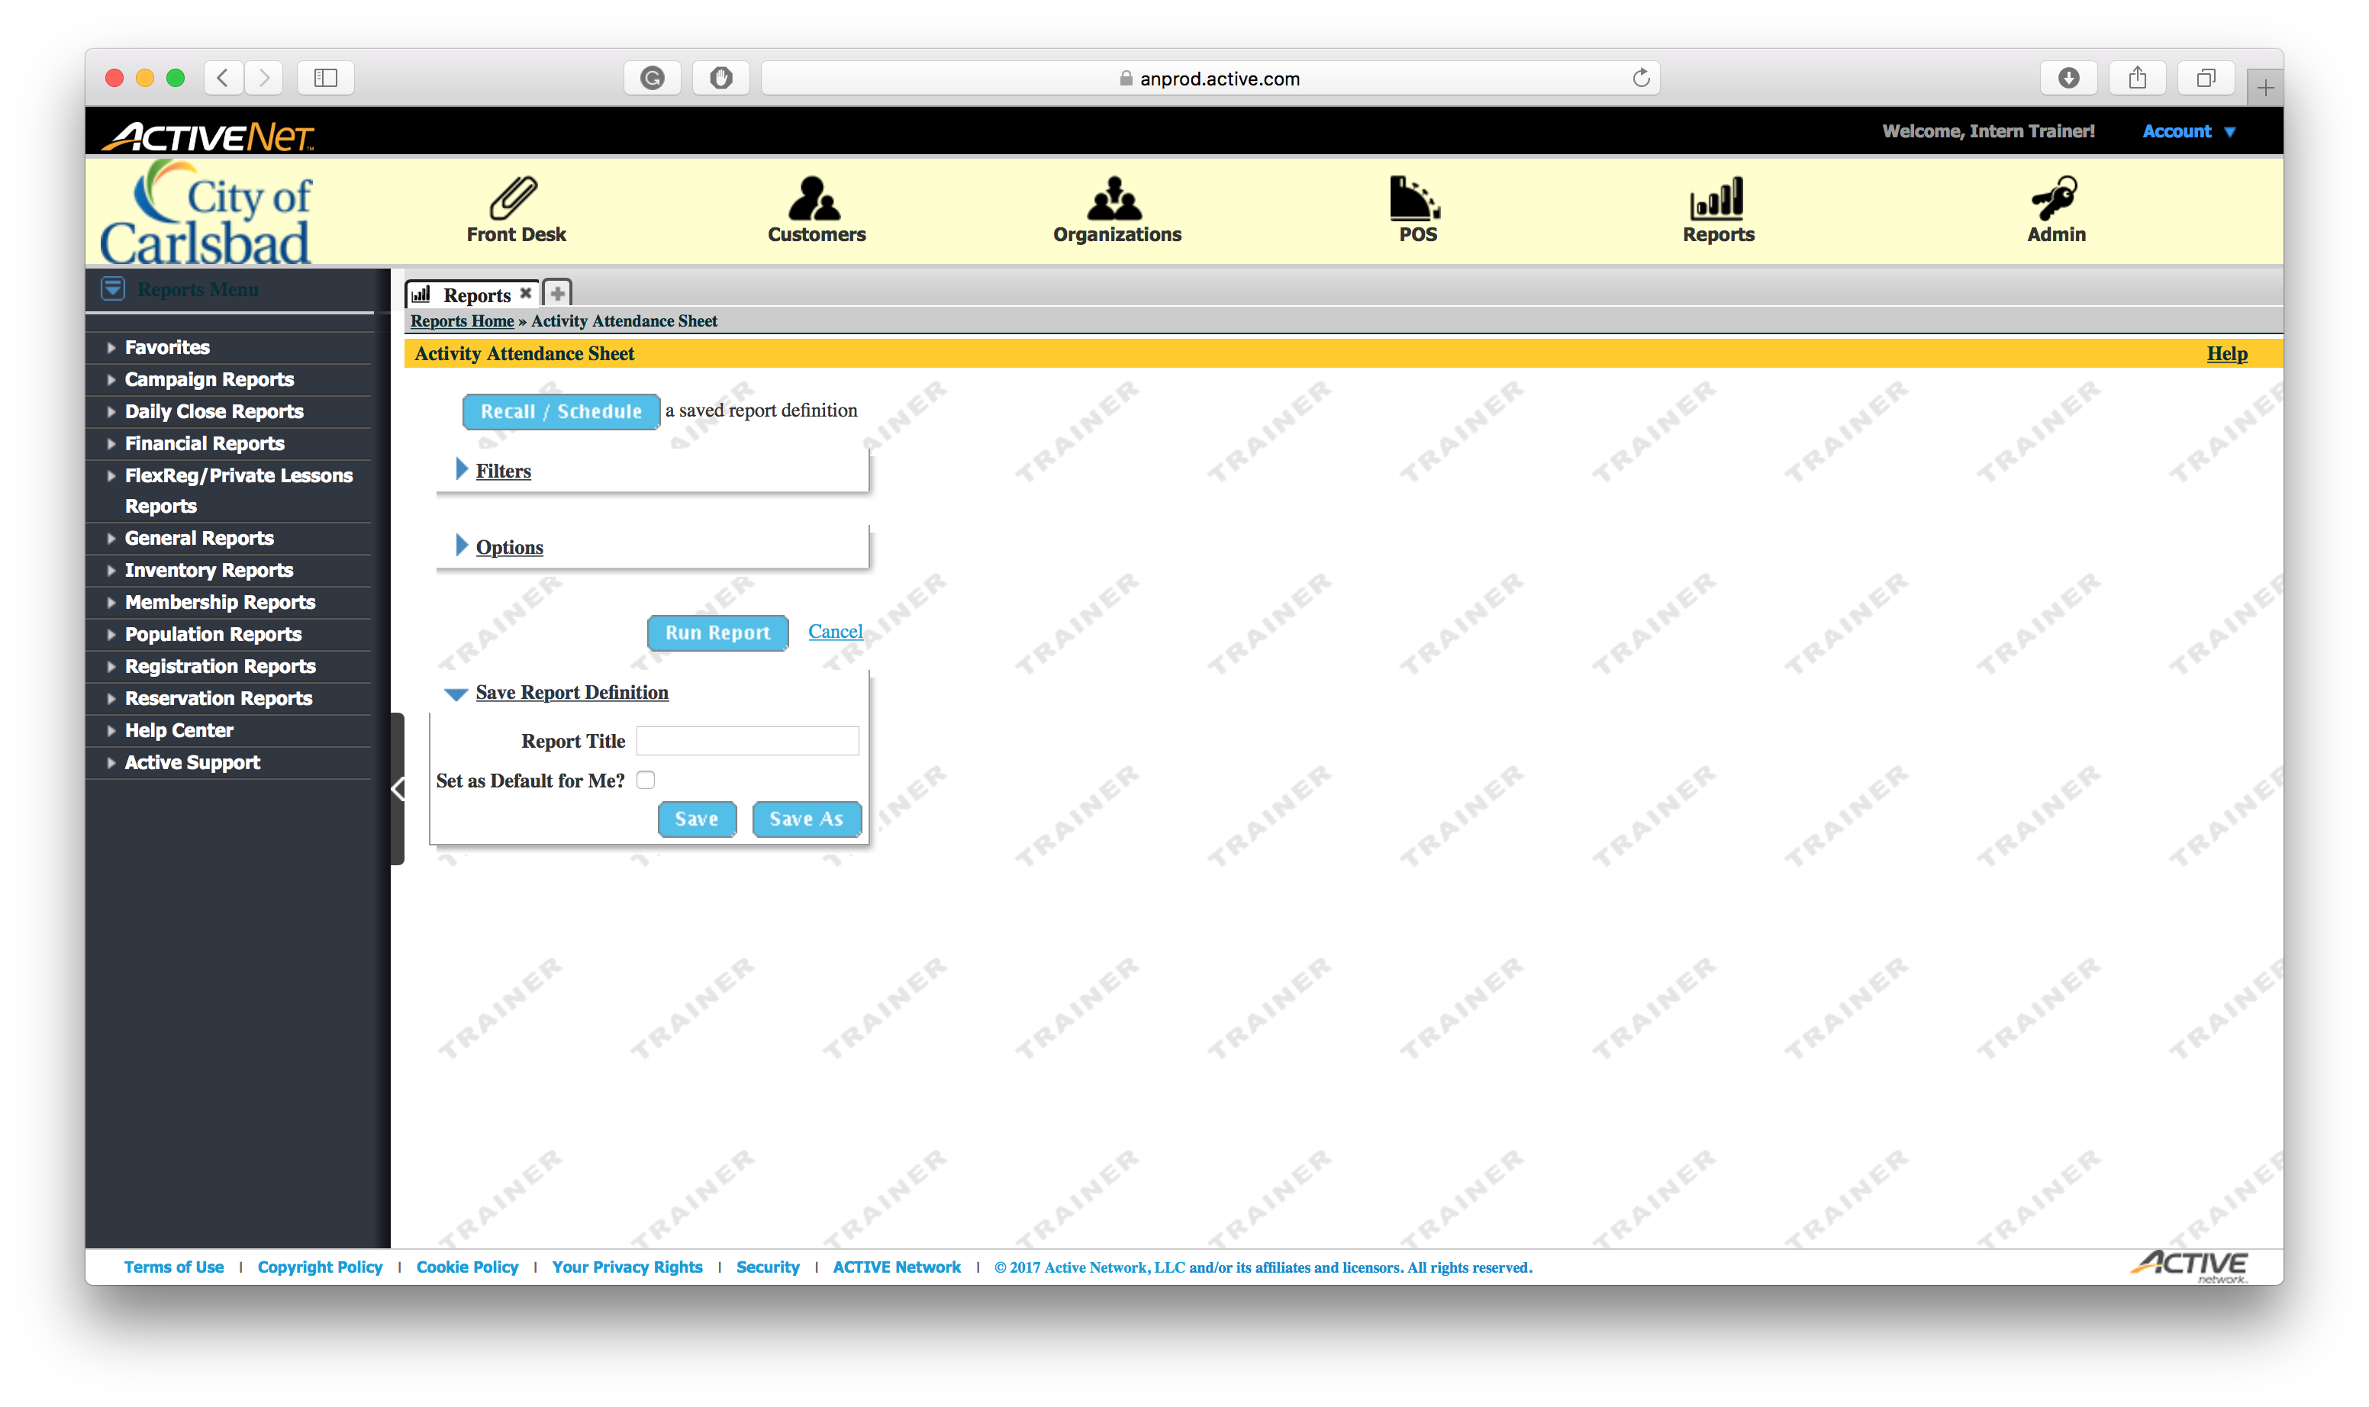
Tip:
Run the Report

Slide 13
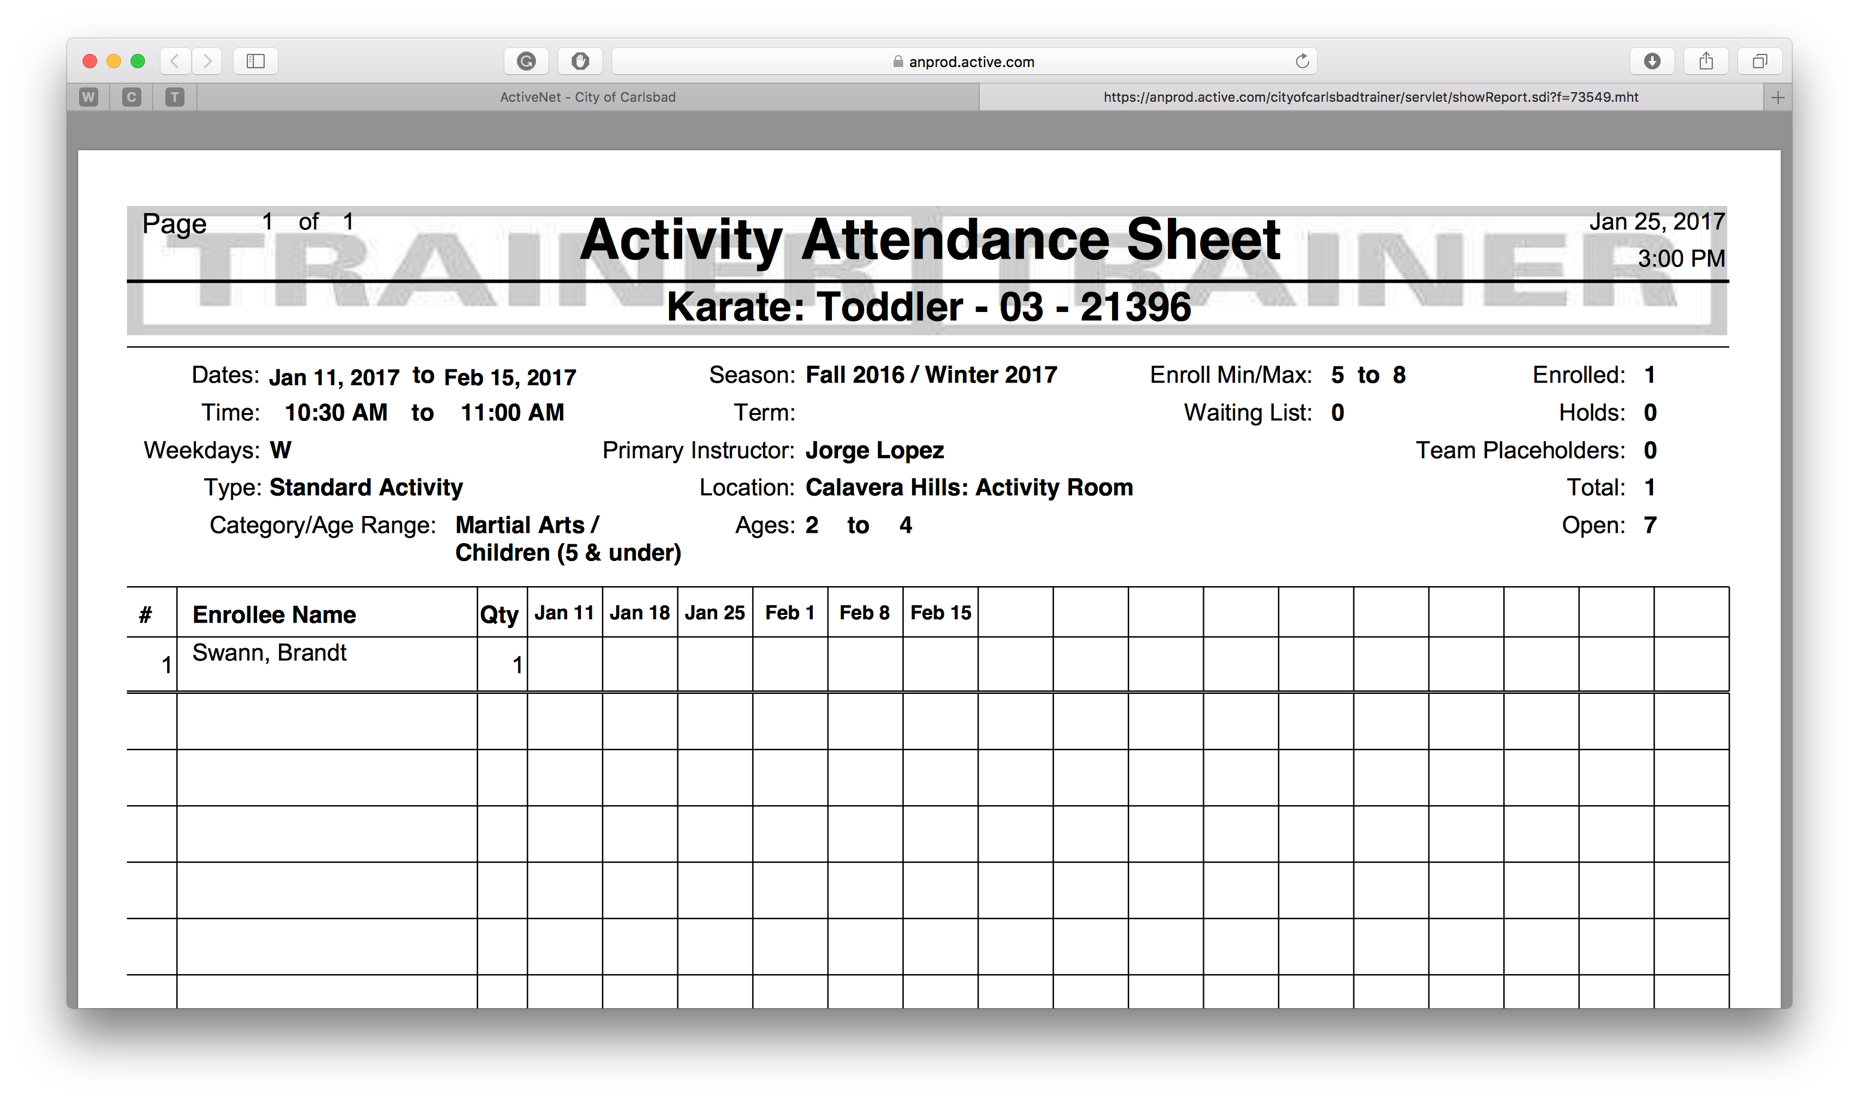
Last-Name, First-Name
Tip:
Click to Finish
This is what the report looks like
You may use this for facility schedules, weekly reservations and more!

